Slide 1
Multispectral Camera In-orbit Operation Instructions (Normal & Emergency)
DFH Satellite Co., Ltd.
Oct, 2019

Slide 2
Outline
Composition
Working Principle and Status
Operation Modes
Telemetry and Tele-command
Instructions for Use
Conclusion

Slide 3

Composition of HRC
Camera includes Camera Main body, Secondary power.

Slide 4
Composition of Camera
imaging spectrum channels
Camera
B1/blue： 0.45±0.02μm ~ 0.52±0.02μm
B2/green：0.52±0.02μm ~ 0.59±0.02μm
B3/red： 0.63±0.02μm ~ 0.69±0.02μm
B4/NIR： 0.77±0.02μm ~ 0.89±0.02μm

Slide 5
Composition of Camera
Camera can acquire the image with the Ground Sampling Distance (GSD) of 13.4m at the orbit altitude of 629km, and a swath of 80km;

Slide 6
Working Status
The default working status and working parameters for Camera are as following:
Main of Camera management controller works in general.
The default imaging parameters of Camera are listed as below.
All the algorithms of Camera （include dark pixel correction and uniformity correction）are set turn on（01）as default。
Band | B1 | B2 | B3 | B4
Gain | BBH | BBH | BBH | BBH

Slide 7
Working Principle
Camera

Slide 8
Functions
to take images in nadir or roll maneuver status;
to transmit image data to DTS;
to adjust some parameters, such as gain;
to realize thermal control by OBDH Thermal Control Loops;
to enter into safe mode automatically after 15min of uninterrupted image taking;

Slide 9
Functions
To perform the imaging radiation calibration to the ground when the satellite yaws ±90°. According to other satellites in orbit calibration experiments , the calibration in orbit always be done nearly once a year.

Slide 10
Operation Modes
Imaging Mode
To take images in nadir
To take images in roll less than ±40°
To take images in ±90°yaw attitude

Slide 11
Telemetry and Tele-command
Tele-command (TC)
Camera
Telemetry (TM)
Camera
Thermal Controller Loops
TM/TC Based on Operation Mode

Slide 12
Tele-command
Camera
Indirect On/Off command controlled by OBDH
KSM037~KSM040
Code | Name | Normal Range
KSM137 | MC Power-on 1st | Voltage 1=4.3V~4.8V
KSM138 | MC Power-on 2nd | Voltage 2=4.3~4.8V, Voltage 3=3.8~4.2V; Voltage 4=4.1~4.5V; Voltage 5=2.2~2.4V.
KSM139 | MC Power-off 1st | Voltage 1=4.3V~4.8V
KSM140 | MC Power-off 2st | Voltage 1=0V Voltage 2=0V, Voltage 3=0V; Voltage 4=0V; Voltage 5=0V.
Notes:
12

Slide 13
Tele-command
Camera
Indirect data command through CAN bus
KHC001-KHC012
code | Parameters name | TC CODE | normal range
KHC001 | MC B1 gain setting | 0C01XXXXH | 0H～1FFH
KHC002 | MC B2 gain setting | 0C02XXXXH | 0H～1FFH
KHC003 | MC B3 gain setting | 0C03XXXXH | 0H～1FFH
KHC004 | MC B4 gain setting | 0C04XXXXH | 0H～1FFH
KHC005 | MC Integration Time Settings | 0C05XXXXH | 01H~0AH.
KHC006 | MC B1 Exposure time Settings | 0C06XXXXH | 01H~0BH.
KHC007 | MC B2Exposure time Settings | 0C07XXXXH | 01H~0BH.
KHC008 | MC B3 Exposure time Settings | 0C08XXXXH | 01H~0BH.
KHC009 | MC B4 Exposure time Settings | 0C09XXXXH | 01H~0BH.
KHC010 | MC Algorithm Settings | 0C0AXXXXH | 01：on，10：off
KHC011 | MC reset CANA | 0C0BAAAAH | reset CANA
KHC012 | MC reset CANB | 0C0CAAAAH | reset CANA
Notes:
13

Slide 14
Telemetry
MC
Fast TM (OBDH directly collecting):
Y10001~Y10005
code | Parameters name | normal range
Y10001 | MC_Voltage 1_Circuit_STATUS | 4.3~4.8V
Y10002 | MC_Voltage 2_Circuit_STATUS | 4.3~4.8V,
Y10003 | MC_Voltage 3_Circuit_STATUS | 3.8~4.2V;
Y10004 | MC_Voltage 4_Circuit_STATUS | 4.1~4.5V;
Y10005 | MC_Voltage 5_Circuit_STATUS | 2.2~2.4V.
Notes:
14

Slide 15
Telemetry
MC-FAST TM (2s period):
code | Parameters name | normal range
AS001 | MC Received_Latest_TC | Received Latest TC content
AS002 | MC Clock status | 1:on 0:off
AS003 | MC Parameter1（right counter） | If received the right TC then counter +1
AS004 | MC Parameter2（wrong counter） | If received the wrong TC then counter +1
AS005 | MC Parameter3（soft check） | 1: normal
AS024 | MC Can bus | 1:CANB;0:CANA
AS025 | MC imageoutput status | 1:0n 0:0ff
AS007 | Received_Wrong_ CAN_data_COUNTER | If received the wrong CAN data then counter +1
AS008 | B1 Gain_Code_SET | 0~1FF
AS009 | B2 Gain_Code_SET | 0~1FF
AS010 | B3 Gain_Code_SET | 0~1FF
AS011 | B4 Gain_Code_SET | 0~1FF
Notes:
15

Slide 16
Telemetry
MC
Fast TM (2s period):
code | Parameters name | normal range
AS013 | Algorithm_ENABLE | on：01 off：10
AS014 | MC Integration_Time_STATUS | 01~0AH
AS015 | MC B1 Exposure time _STATUS | 01~0BH
AS016 | MC B2 Exposure time _STATUS | 01~0BH
AS017 | MC B3 Exposure time _STATUS | 01~0BH
AS018 | MC B4 Exposure time _STATUS | 01~0BH
AS019 | MC reset CANA counter | Counter+1
AS020 | MC reset CANB counter | Counter+1
Notes:
16

Slide 17
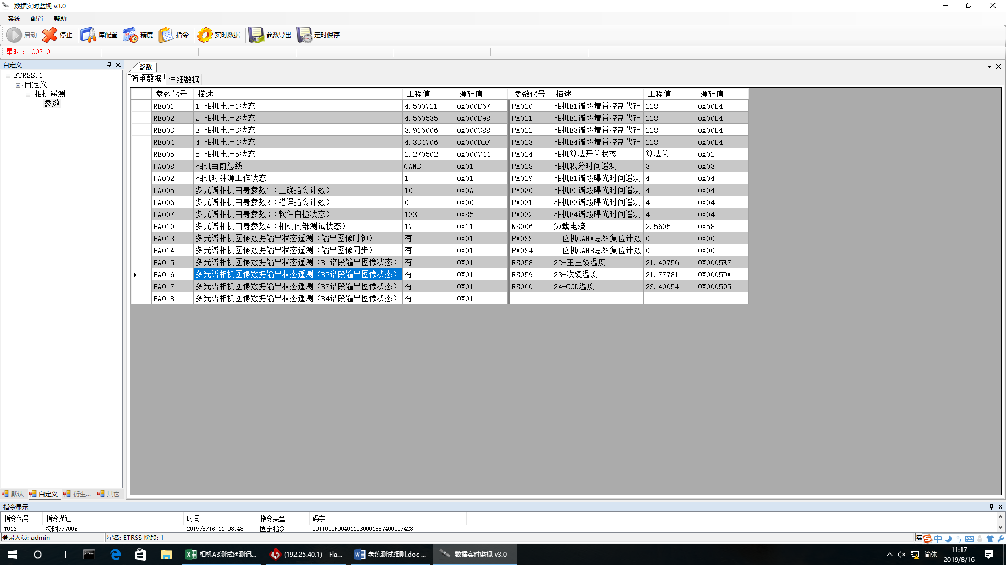
Telemetry
Example
Notes:
17

Slide 18
Data block 57 byte
NO. | Byte | name | instruction | discrption
 | W0 | B1 Exposure time Settings&gain setting | D15~D12： Exposure time CODE | 01~0BH
 | W1 |  | D11~D0： Gain CODE( 10bit) | 0~1FFH
 | W2 | B2 Exposure time Settings&gain setting | D15~D12： Exposure time CODE | 01~0BH
 | W3 |  | D11~D0： Gain CODE( 10bit) | 0~1FFH
 | W4 | B3 Exposure time Settings&gain setting | D15~D12： Exposure time CODE | 01~0BH
 | W5 |  | D11~D0： Gain CODE( 10bit) | 0~1FFH
 | W6 | B4 Exposure time Settings&gain setting | D15~D12： Exposure time CODE | 01~0BH
 | W7 |  | D11~D0： Gain CODE( 10bit) | 0~1FFH
 | W8 | Integration Time Settings/Algorithm Settings | D7~D4： Algorithm Settings | on：01H off：02H
 |  |  | D3~D0： Integration Time Settings | 01~0AH
 | W9~W56 | filling“AA”
Notes:
18

Slide 19
Telemetry
Camera Thermal Controller Loops
Slow TM:
Title of Temperature TM
Package 1:Loop1~12
Notes:
19

Slide 20
Telemetry
P47W22~W24B23~B12 | RS047 | 11_+Y_Skin_of_+Z_TEMPERATURE | %f
P47W22~W24B11~B0 | RS048 | 12_+Y_Skin_of_-Z_TEMPERATURE | %f
P47W25~W27B23~B12 | RS049 | 13_-Y_Skin_of_-Z_TEMPERATURE | %f
P47W25~W27B11~B0 | RS050 | 14_-Y_Skin_of_+Z_TEMPERATURE | %f
P47W28~W30B23~B12 | RS051 | 15_Top_of_+Z_frame_TEMPERATURE | %f
P47W28~W30B11~B0 | RS052 | 16_Bottom_of_+Z_frame_TEMPERATURE | %f
P47W31~W33B23~B12 | RS053 | 17_Back_Skin_TEMPERATURE | %f
P47W31~W33B11~B0 | RS054 | 18_Upper_of_Back_Skin_TEMPERATURE | %f
P47W34~W36B23~B12 | RS055 | 19_Bottom_of_Back_Skin_TEMPERATURE | %f
P47W34~W36B11~B0 | RS056 | 20_Focal_plane_splice_lens_frame_TEMPERATURE | %f
P47W37~W39B23~B12 | RS057 | 21_Focal_circuit_Inside_frame_TEMPERATURE | %f
P47W37~W39B11~B0 | RS058 | 22-Main&Third_lens_cover_TEMPERATURE | %f
P47W40~W42B23~B12 | RS059 | 23-Secondary_lens_cover_TEMPERATURE | %f
P47W40~W42B11~B0 | RS060 | 24-CCD_TEMPERATURE | %f
Notes:
20

Slide 21
TC Based on Operation Mode
Imaging Mode
TC Number | TC Name | TC Code
KSM137 | MC Power-on 1st | 007015AAH
KSM138 | MC Power-on 2nd | 007016AAH
KSM139 | MC Power-off 1st | 007017AAH
KSM140 | MC Power-off 2st | 007018AAH
Notes:
21

Slide 22
TM/TC Based on Operation Mode
TDI stages for PMC
Imaging Mode– reference to imaging parameter setting
Default Value
Band | B1 | B2 | B3 | B4
Algorithm_ENABLE | 01H
Gain | BBH | BBH | BBH | BBH
Notes:
22

Slide 23
TM/TC Based on Operation Mode
TDI stages for PMC
Imaging Mode– reference to imaging parameter setting
solar elevation（°） | Gain dB
 | B1 | B2 | B3 | B4
≥60° | 4dB | 2dB | 4dB | 2dB
(50°-60°] | 4dB | 2dB | 4dB | 4dB
(40°-50°] | 6dB | 4dB | 6dB | 4dB
(30°-40°] | 8dB | 6dB | 8dB | 6dB
（20°-30°] | 10dB | 8dB | 10dB | 10dB
≤20° | 12dB | 12dB | 12dB | 12dB
Notes:
23

Slide 24
Instructions for Use
Basic Working Constraint
Working Rules Camera Subsystem
Anomaly to Handle

Slide 25
Instructions for Use
Basic Working Constraint
Camera is recommended to acquire images in sunlight in normal case.
Temperature of MC’s TDICCD shall be lower than 28°C
MC accumulated working period per rev: no more than 8 minutes
MC accumulated working time per day: less than 75 minutes
warning

Slide 26
Instructions for Use
Working Rules of Camera-imaging mode
While imaging mode,
MC can receive valid data tele-command and collect telemetry
MC can implement imaging steps.

Slide 27
Instructions for Use
Working Rules of HRC-imaging mode
Camera can implement camera imaging power-on command.
After this command camera can normally acquire images;
10s after this command imaging parameters, such as gain can be set too;
Camera will turn off automaticlly on 15mins after this command

Slide 28
Instructions for Use
Working Rules of Camera-imaging mode
Setting imaging parameters:
Gain if necessary
It is suggested that the working parameters of camera, as below, should not be adjusted in the duration of imaging:
Integration time setting
Algorithm ON/OFF Setting

Slide 29
Instructions for Use
Working Rules
The accumulative time duration of camera power on is no more than 8 minutes in one orbit, and the accumulative time duration limitation is no more than 70 minutes for one day.
Camera can only work at daytime, so sunlight will light on either +X plan or –X plan of satellite during imaging. Satellite should yaw +90° to do the calibration mode if sunlight is on the +X plan before yaw maneuver, or satellite should yaw -90° to do the calibration mode if sunlight is on the -X plan before yaw maneuver
Notes:
It is because that long wave detector needs 2mins to get a stable temperature, and black body calibration must be done after detector maintain a stable temperature (60K±5K)

Slide 30
Instructions for Use
Anomaly to Handle
Basics
If there are some anomalies for camera, it is needed to report immediately.
Anomaly category: output anomaly, working status anomaly.

Slide 31
Instructions for Use
Output anomaly
Status: camera cannot normally output image during performing mission
To handle: Report to DFH immediately with all the working status telemetry of camera
Working status anomaly
Status: Working status telemetry is abnormal during performing mission, however, camera can output image.
To handle: Report to DFH with all the working status telemetry of camera

Slide 32
Thank your attention!

